Slide 1

Introduction to Machine Learning
Supervised Learning
By <Trainer’s Name>
<Date>

Slide 2
Naive Bayes Classifier
<Topic>

Slide 3


Naïve Bayes Classifier
What is Naïve Bayes Classifier?
Naive Bayes classifier assumes that the presence of a particular feature in a class is unrelated to the presence of any other feature
RED
ROUND
3inches in Diameter

Slide 4

Naïve Bayes Classifier
Why is Naïve Bayes so Naive?
Because it makes assumptions that may or may not be correct

Slide 5
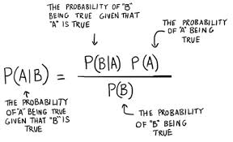
Naïve Bayes Classifier
Why does it contain Bayes?
Because its fundamentals are based on the Bayes Theorem

Slide 6
Naïve Bayes Classifier
Understanding Conditional Probability
Calculate the probability of the second event (event B) given that the first event (event A) has already happened.
For example:
Drawing a second ace from a deck given we got the first ace
Finding the probability of having a disease given you were tested positive
Finding the probability of liking Game of Thrones given the person likes fiction

Slide 7

Naïve Bayes Classifier
Understanding Conditional Probability
Define 2 events…
Event A is the probability of the event we’re trying to calculate
Event B is the condition that we know or the event that has happened
Conditional Probability : P(A|B) ,
The probability of the occurrence of event A given that B has already happened

Slide 8
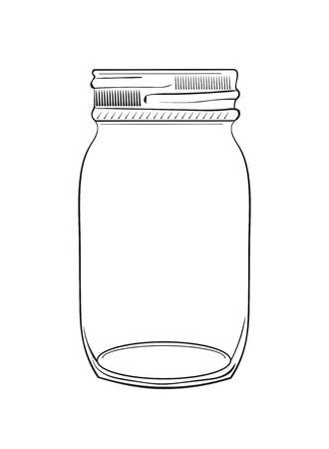


Naïve Bayes Classifier
Understanding Conditional Probability
Suppose you have a jar containing 6 marbles – 3 black and 3 red. What is the probability of getting a black given the first one was black too?

Slide 9

Naïve Bayes Classifier
Understanding Conditional Probability
Suppose you have a jar containing 6 marbles – 3 black and 3 red. What is the probability of getting a black given the first one was black too?
P (A) = getting a black marble in the first turn
P (B) = getting a black marble in the second turn
P (A) = 3/6
P (B) = 2/5
P (A B) = ½*2/5 = 1/5

Slide 10


Naïve Bayes Classifier
Understanding Conditional Probability
John’s favorite breakfast is cereal and his favorite lunch is pizza
The probability of John having cereal for breakfast is 0.6
The probability of him having pizza for lunch is 0.5
The probability of him, having a cereal for breakfast given that he eats a pizza for lunch is 0.7

Slide 11

Naïve Bayes Classifier
Understanding Conditional Probability
Now, what if I want to know the probability of having a pizza given you had a bowl of cereal for breakfast.
So, you have to calculate:
Now this is where, Bayes Theorem Comes into Picture..

Slide 12

Naïve Bayes Classifier
Understanding Bayes Theorem
The Bayes theorem describes the probability of an event based on the prior knowledge of the conditions that might be related to the event.
In simple words,
Bayes' theorem shows the relation between a conditional probability and its reverse form.
If conditional probability =
Use Bayes rule to find the reverse probabilities =

Slide 13

Naïve Bayes Classifier
Bayes Theorem: Use Case
Find out a patient’s probability of having liver disease if they are an alcoholic

Slide 14
Naïve Bayes Classifier
Understanding Bayes Theorem
A event “Patient has liver disease.” Past data tells you that 10% of patients entering your clinic have liver disease. P(A) = 0.10
B test that “Patient is an alcoholic.” Five percent of the clinic’s patients are alcoholics. P(B) = 0.05
You might also know that among those patients diagnosed with liver disease, 7% are alcoholics. This is your B|A: probability that a patient is alcoholic, given that they have liver disease, is 7%.

Slide 15
Naïve Bayes Classifier
Understanding Bayes Theorem
According to Bayes’ theorem:
P(A|B) = (0.07 * 0.1)/0.05 = 0.14
In other words, if the patient is an alcoholic, their chances of having liver disease is 0.14 (14%). This is a large increase from the 10% suggested by past data. But it’s still unlikely that any particular patient has liver disease.

Slide 16
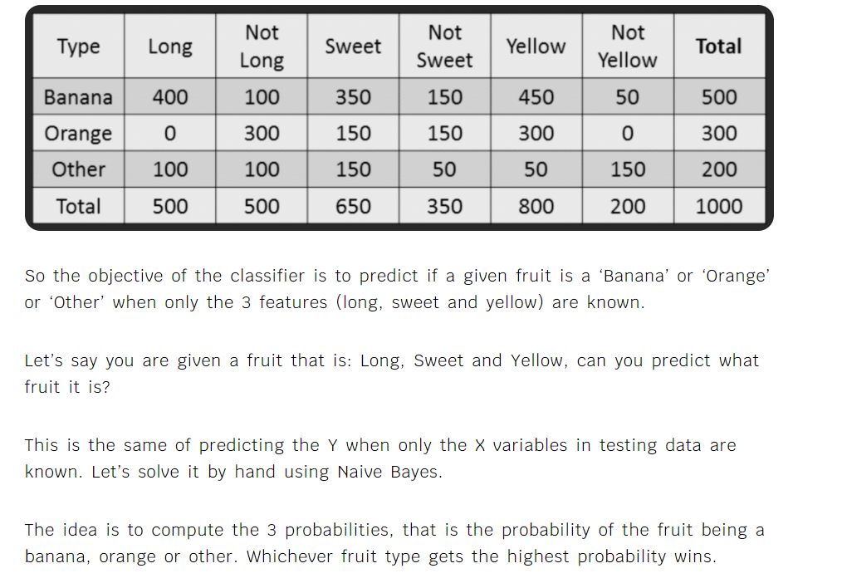

Slide 17
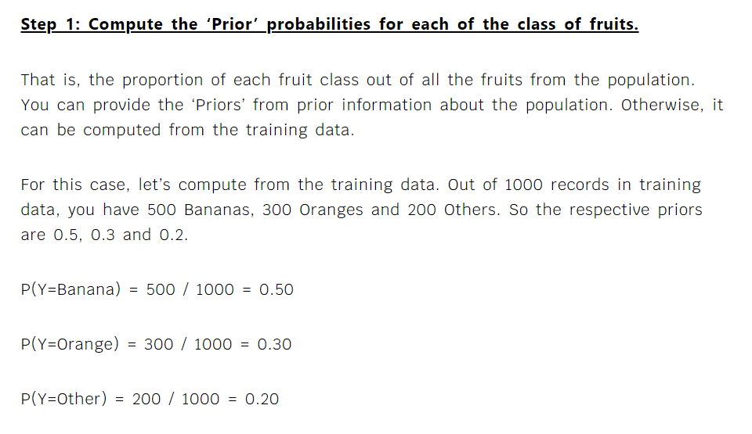

Slide 18
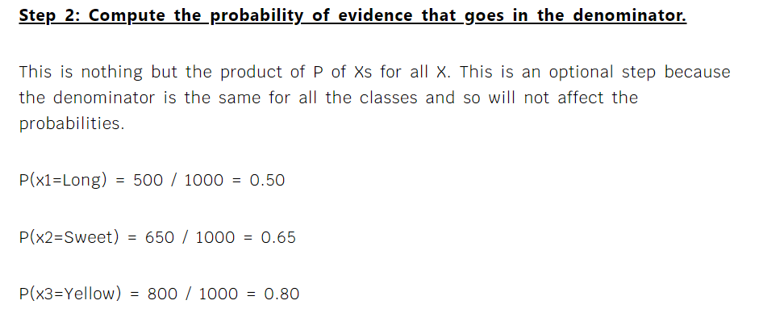

Slide 19
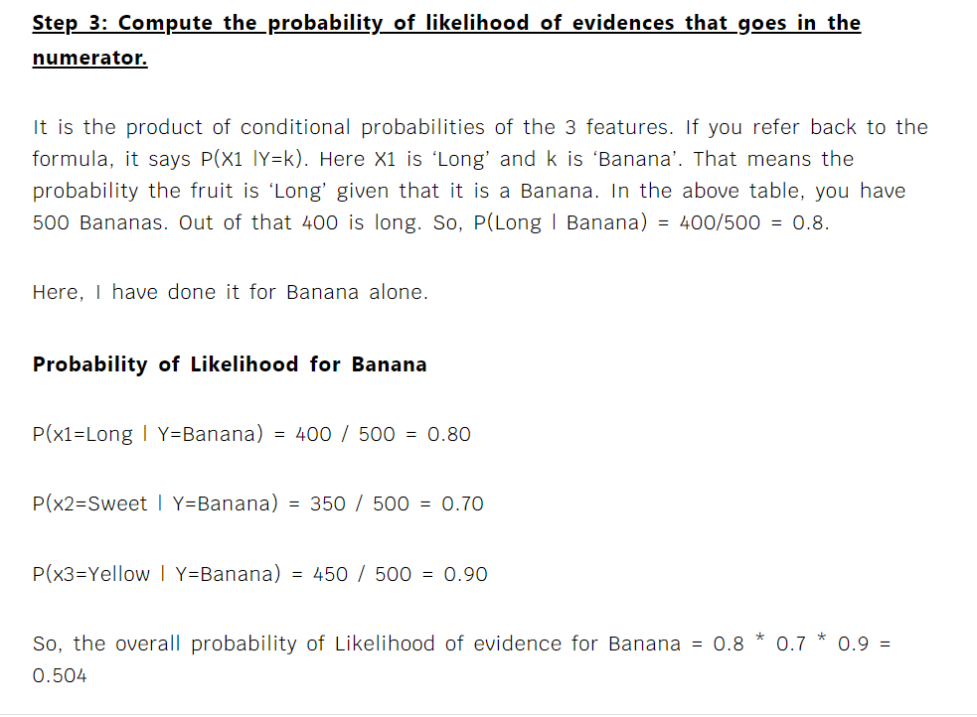

Slide 20
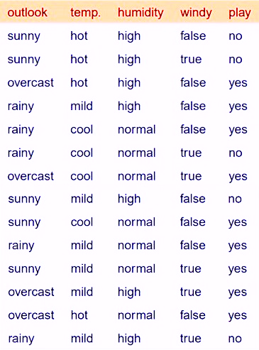
Naïve Bayes Classifier
D1
D2
D3
D4
D5
D6
D7
D8
D9
D10
D11
D12
D13
D14
Should I play Today?
Total Sample: 14
Total Yes: 9
Total No: 5
P(Yes): 9/14
P(No): 5/14

Slide 21
Naïve Bayes Classifier
D1
D2
D3
D4
D5
D6
D7
D8
D9
D10
D11
D12
D13
D14
Frequency Table each attribute
Outlook
 | Yes | No
Sunny | 2 | 3
Overcast | 4 | 0
Rainy | 3 | 2
Total | 9 | 5
Temperature
 | Yes | No
Hot | 2 | 2
Mild | 4 | 2
Cool | 3 | 1
Total: | 9 | 5
Humidity
 | Yes | No
High | 3 | 4
Normal | 6 | 1
Total | 9 | 5
Windy
 | Yes | No
False | 6 | 2
True | 3 | 3
Total: | 9 | 5

Slide 22
Naïve Bayes Classifier
D1
D2
D3
D4
D5
D6
D7
D8
D9
D10
D11
D12
D13
D14
Probability for each attribute: P(A)
Outlook
 | Yes | No | P(attrib)
Sunny | 2 | 3 | 5/14
Overcast | 4 | 0 | 4/14
Rainy | 3 | 2 | 5/14
Total | 9 | 5 | 100%
Temperature
 | Yes | No | P(attrib)
Hot | 2 | 2 | 4/14
Mild | 4 | 2 | 6/14
Cool | 3 | 1 | 4/14
Total: | 9 | 5 | 100%
Humidity
 | Yes | No | P(attrib)
High | 3 | 4 | 7/14
Normal | 6 | 1 | 7/14
Total | 9 | 5 | 100%
Windy
 | Yes | No | P(attrib)
False | 6 | 2 | 8/14
True | 3 | 3 | 6/14
Total: | 9 | 5 | 100%

Slide 23
Naïve Bayes Classifier
D1
D2
D3
D4
D5
D6
D7
D8
D9
D10
D11
D12
D13
D14
Probability for each attribute: P(B)
Play |  | Probability
Yes | 9 | 9/14
No | 5 | 5/14
Total | 14 | 100%

Slide 24
Naïve Bayes Classifier
D1
D2
D3
D4
D5
D6
D7
D8
D9
D10
D11
D12
D13
D14
Likelihood for each attribute: P(A|B)
Outlook
 | Yes | No | P(Yes) | P(No)
Sunny | 2 | 3 | 2/9 | 3/5
Overcast | 4 | 0 | 4/9 | 0/5
Rainy | 3 | 2 | 3/9 | 2/5
Total | 9 | 5 | 100% | 100%
Temperature
 | Yes | No | P(Yes) | P(No)
Hot | 2 | 2 | 2/9 | 2/5
Mild | 4 | 2 | 4/9 | 2/5
Cool | 3 | 1 | 3/9 | 1/5
Total: | 9 | 5 | 100% | 100%
Humidity
 | Yes | No | P(Yes) | P(No)
High | 3 | 4 | 3/9 | 4/5
Normal | 6 | 1 | 6/9 | 1/5
Total | 9 | 5 | 100% | 100%
Windy
 | Yes | No | P(Yes) | P(No)
False | 6 | 2 | 6/9 | 2/5
True | 3 | 3 | 3/9 | 3/5
Total: | 9 | 5 | 100% | 100%
Play |  | Probability
Yes | 9 | 9/14
No | 5 | 5/14
Total | 14 | 100%

Slide 25
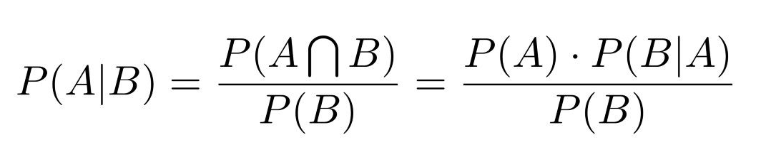
Naïve Bayes Classifier
Now we have to calculate : P(B | A)
Outlook
 | Yes | No | P(attrib)
Sunny | 2 | 3 | 5/14
Overcast | 4 | 0 | 4/14
Rainy | 3 | 2 | 5/14
Total | 9 | 5 | 100%
Temperature
 | Yes | No | P(attrib)
Hot | 2 | 2 | 4/14
Mild | 4 | 2 | 6/14
Cool | 3 | 1 | 4/14
Total: | 9 | 5 | 100%
Ideal condition:
P(Outlook = Sunny) = 5/14
P(Temperature = Cool) = 4/14
P(Humidity = Normal) = 7/14
Humidity
 | Yes | No | P(attrib)
High | 3 | 4 | 7/14
Normal | 6 | 1 | 7/14
Total | 9 | 5 | 100%
Windy
 | Yes | No | P(attrib)
False | 6 | 2 | 8/14
True | 3 | 3 | 6/14
Total: | 9 | 5 | 100%
P(Wind = False) = 8/14
Probability of ideal condition:
P(X) =(5/14)*(4/14)*(7/14)*(8/14)
P(X) = 0.029
Play |  | Probability
Yes | 9 | 9/14
No | 5 | 5/14
Total | 14 | 100%

Slide 26
Naïve Bayes Classifier
Outlook
 | Yes | No | P(Yes) | P(No)
Sunny | 2 | 3 | 2/9 | 3/5
Overcast | 4 | 0 | 4/9 | 0/5
Rainy | 3 | 2 | 3/9 | 2/5
Total | 9 | 5 | 100% | 100%
Temperature
 | Yes | No | P(Yes) | P(No)
Hot | 2 | 2 | 2/9 | 2/5
Mild | 4 | 2 | 4/9 | 2/5
Cool | 3 | 1 | 3/9 | 1/5
Total: | 9 | 5 | 100% | 100%
Probability of playing the game in ideal condition:
P(Yes|X) =
P(X|Yes) x P(Yes)
P(X)
Humidity
 | Yes | No | P(Yes) | P(No)
High | 3 | 4 | 3/9 | 4/5
Normal | 6 | 1 | 6/9 | 1/5
Total | 9 | 5 | 100% | 100%
Windy
 | Yes | No | P(Yes) | P(No)
False | 6 | 2 | 6/9 | 2/5
True | 3 | 3 | 3/9 | 3/5
Total: | 9 | 5 | 100% | 100%
0.033 x (9/14)
P(Yes|X) =
0.029
Play |  | Probability
Yes | 9 | 9/14
No | 5 | 5/14
Total | 14 | 100%
P(Yes|X) =
0.73

Slide 27
Boosting
<Topic>

Slide 28
Boosting
Boosting has been a very successful technique for solving the
two-class classification problem.
Rather than just combining the isolated classifiers boosting use the mechanism of increasing the weights of misclassified data in preceding classifiers.
A weak learner is defined to be a classifier which is only slightly correlated with the true classification.
In contrast, a strong learner is a classifier that is arbitrarily well- correlated with the true classification.

Slide 29
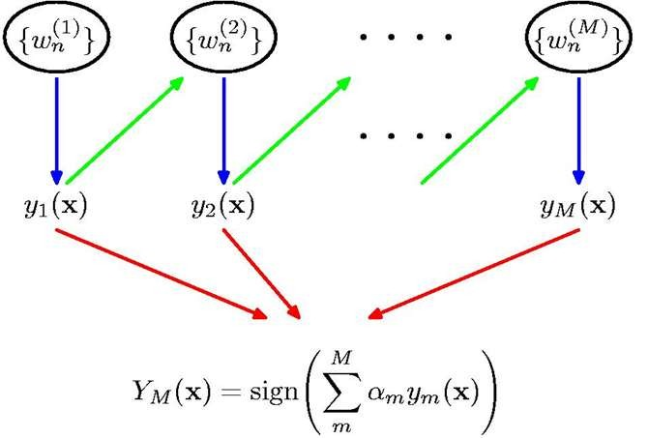
Boosting

Slide 30
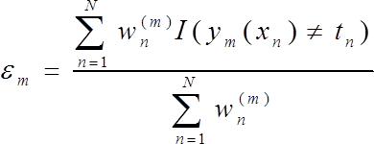
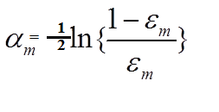
AdaBoost Algotithm
Initialize the data weighting coefficients {W_{n} } by setting W_{i} = 1/n, for n=1,2……..,N
For m=1 to m
Fit a classifier y_{𝑚}(x) to the training data by minimizing the weighted error function.
Evaluate the quantities
The term I(y_{m}(x_{n})≠t_{n}) is indication function has values 0/1, 0 if x_{n} is properly classified 1 if not so.
And use these to evaluate
Update the data weighting coefficients

Slide 31

AdaBoost Algotithm
3. Make predictions using the final model, which is given by

Slide 32


Thank You

